Slide 1
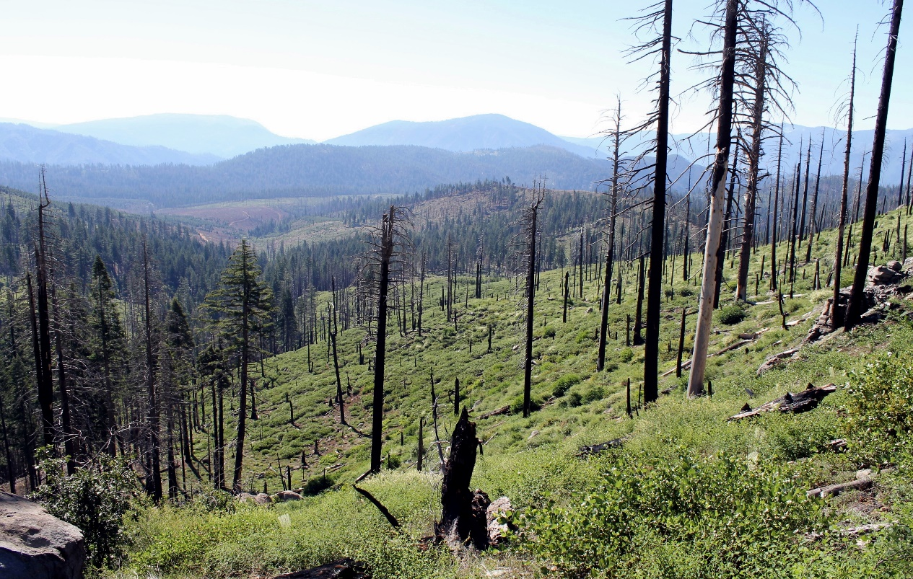
Post-fire regeneration strategies:
Who wins, and who loses after short-interval reburns?
Notes:
Map of our study area in the Lassen National Forest: the Storrie Fire outlined in black occurred in 2000 – 20,000 hectares. Chips Fire in blue 2012 – 30,000 hectares. Study was conducted within this 9,000-hectare overlap area.

Slide 2
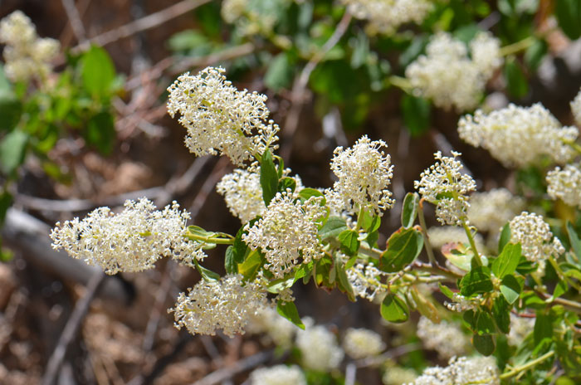
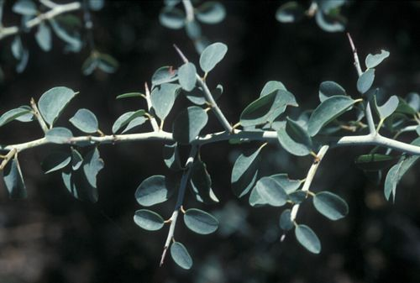
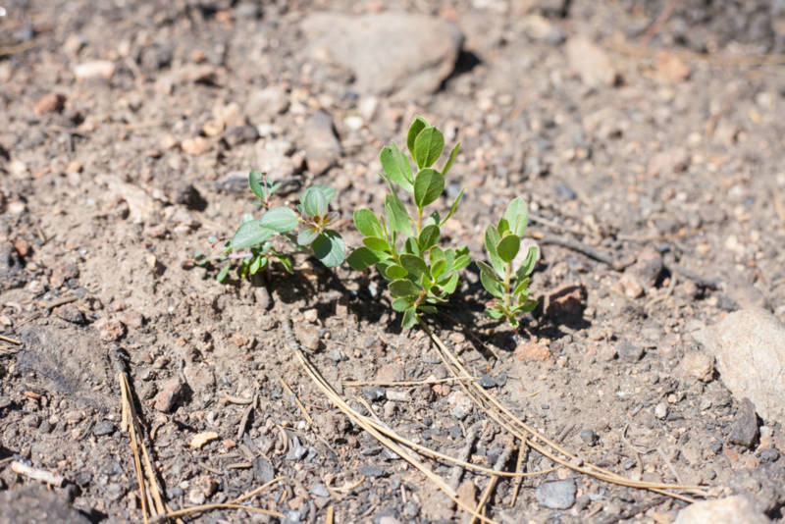
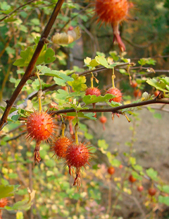
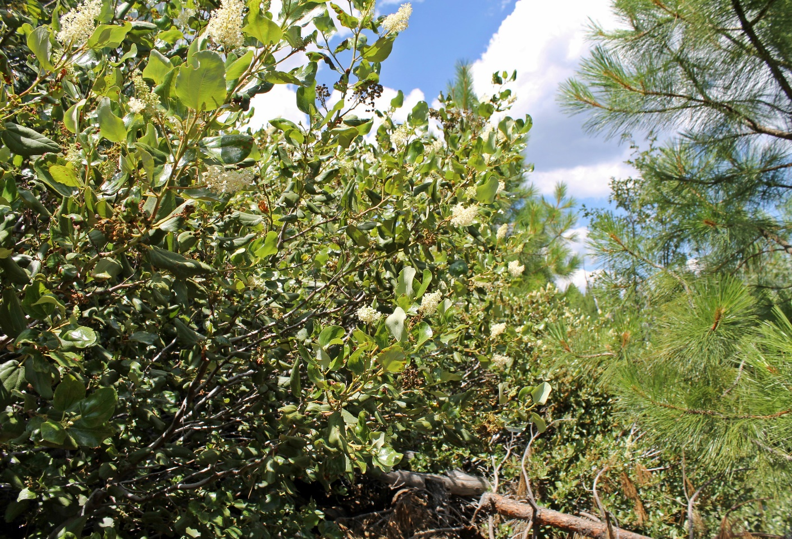
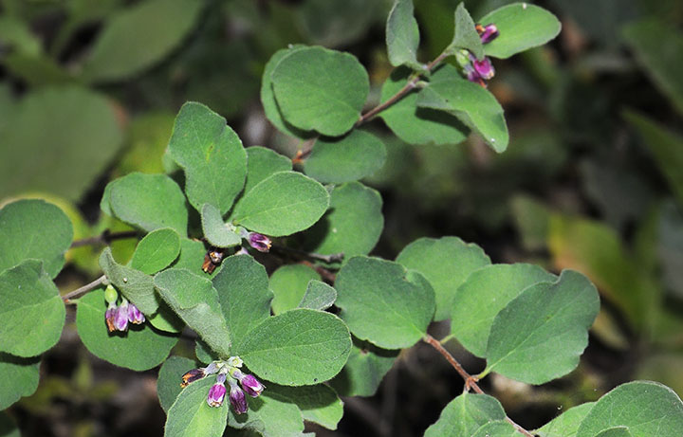
Montane chaparral
Deerbrush
(Ceanothus integerrimus)
Mountain whitethorn
(Ceanothus cordulatus)
Greenleaf mazanita
(Arctostaphylos patula)
Sierra gooseberry
(Ribes roezlii)
Snowbrush
(Ceanothus velutinus)
Trailing snowberry
(Symphoricarpos mollis)

Slide 3
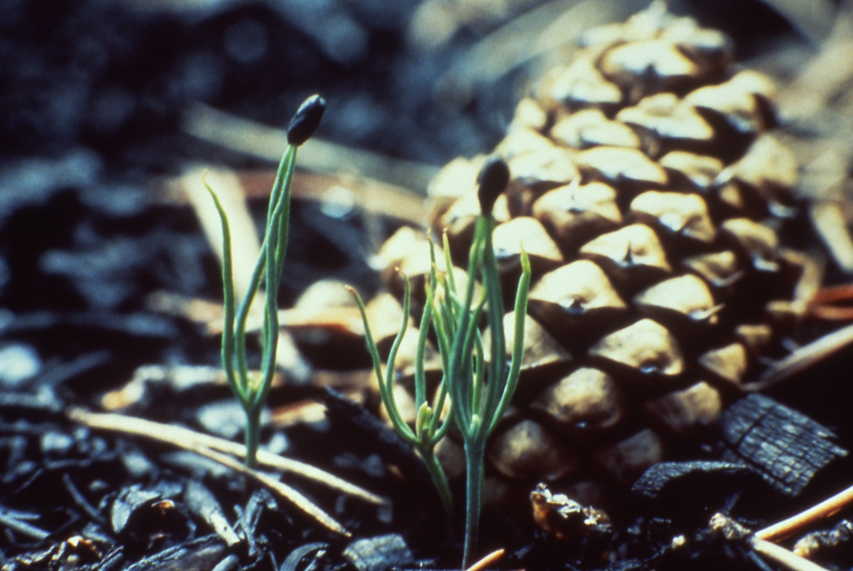
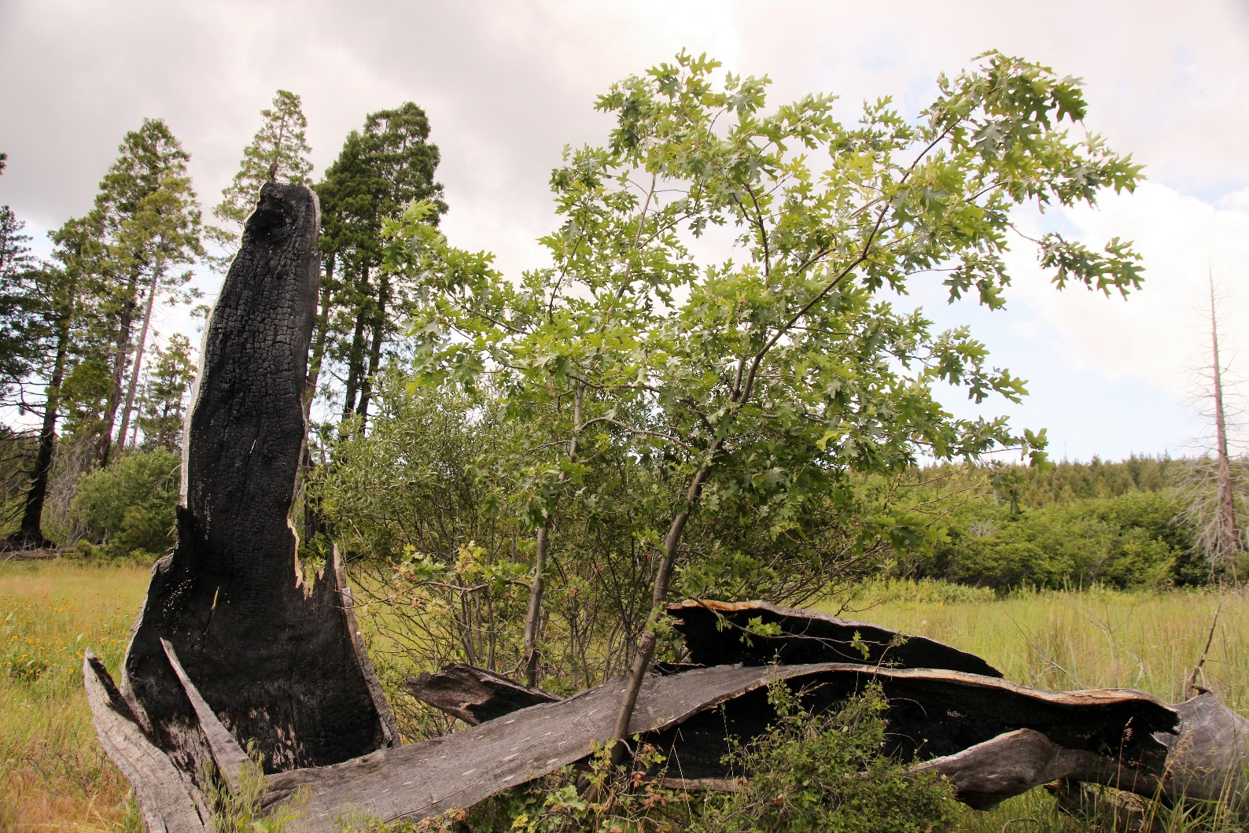
Regeneration strategies
Evaders:
Fire-induced germination
Endurers:
sprouting

Slide 4
Montane chaparral
Deerbrush
(Ceanothus integerrimus)
Mountain whitethorn
(Ceanothus cordulatus)
Greenleaf mazanita
(Arctostaphylos patula)
Seeders
Sierra gooseberry
(Ribes roezlii)
Snowbrush
(Ceanothus velutinus)
Trailing snowberry
(Symphoricarpos mollis)
Sprouters

Slide 5
Obligate seeders
Obligate sprouters
Deerbrush
(Ceanothus integerrimus)
Sierra gooseberry
(Ribes roezlii)
Mountain whitethorn
(Ceanothus cordulatus)
Facultative sprouter/seeders:
Severity-dependent fire response
Snowbrush
(Ceanothus velutinus)
Greenleaf mazanita
(Arctostaphylos patula)
Trailing snowberry
(Symphoricarpos mollis)

Slide 6
Research Questions:
Does frequent fire favor one regeneration strategy over another?
How do repeat fires affect species composition?
Does frequent fire favor one regeneration strategy over another?
How do repeat fires affect species composition?
Does frequent fire favor one regeneration strategy over another?
How do repeat fires affect species composition?

Slide 7
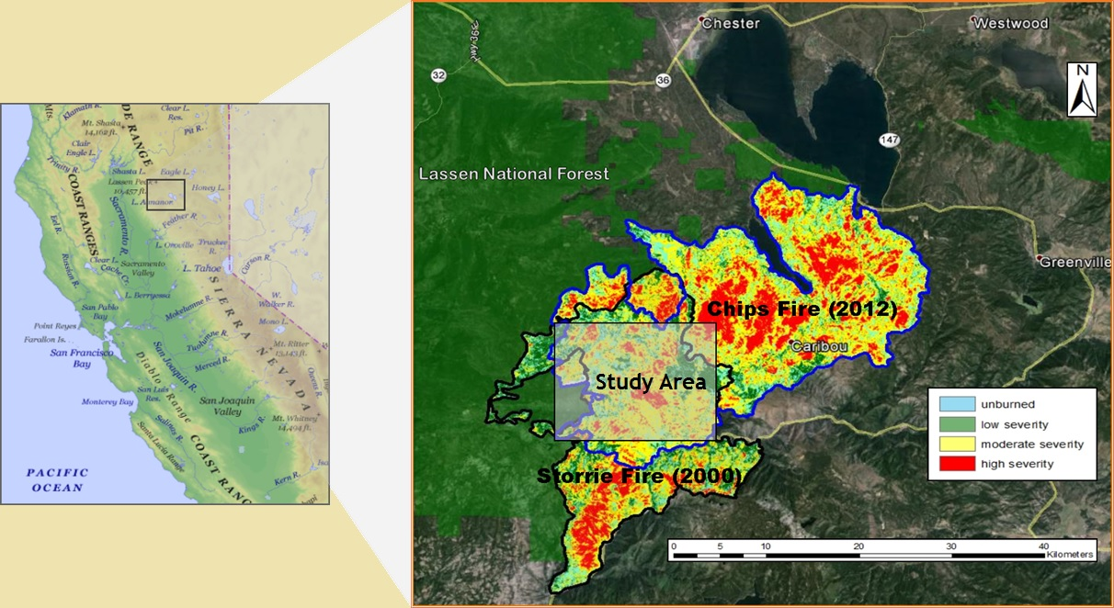
Study Area

Slide 8
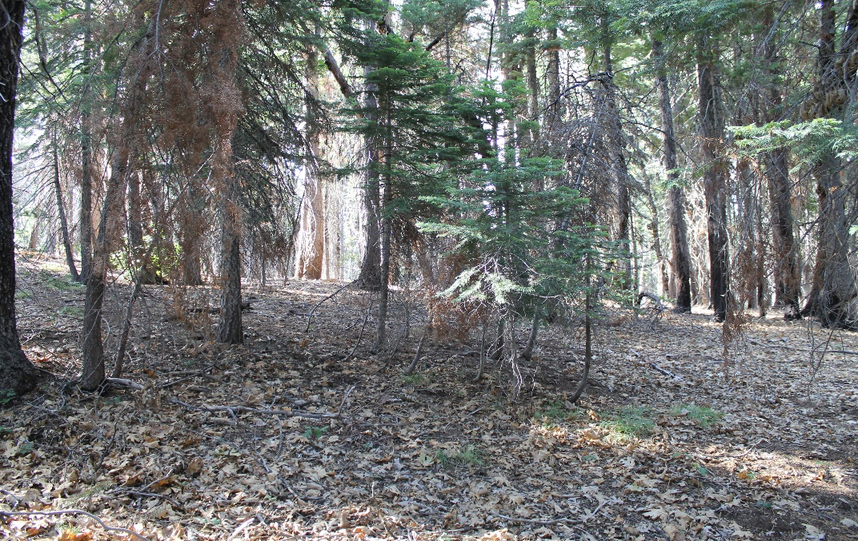
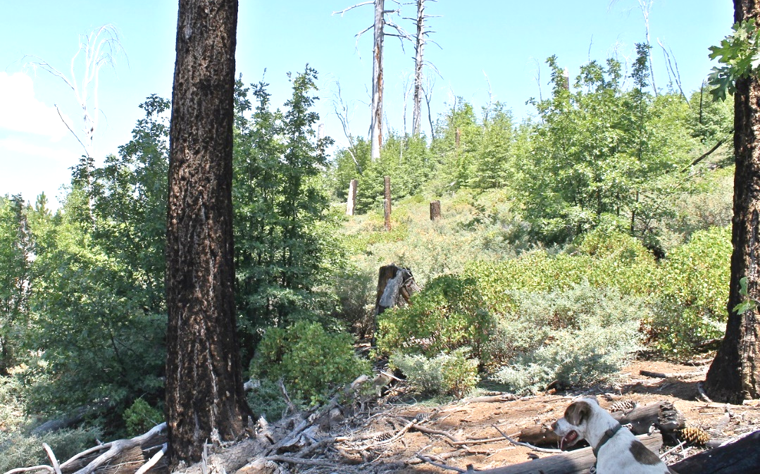
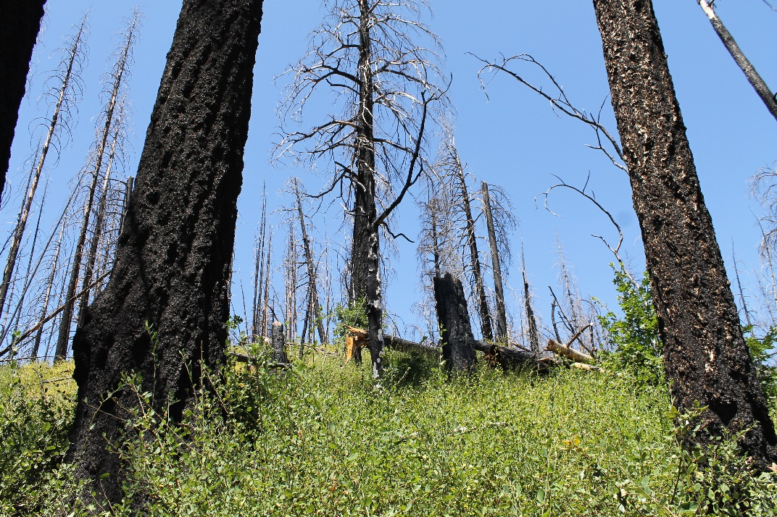
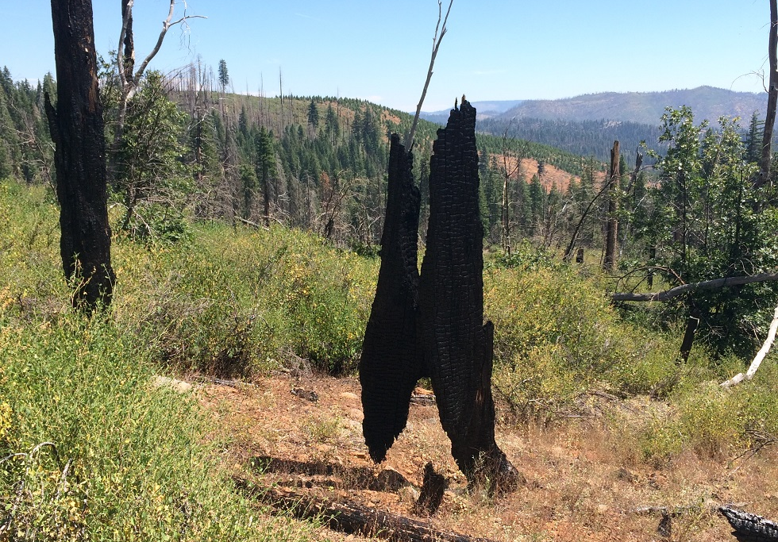
Methods
Low/Low
High/Low
93 fixed-area plots
314m² area
Low/High
High/High
Overstory mortality
Ocular percent cover of shrub species

Slide 9

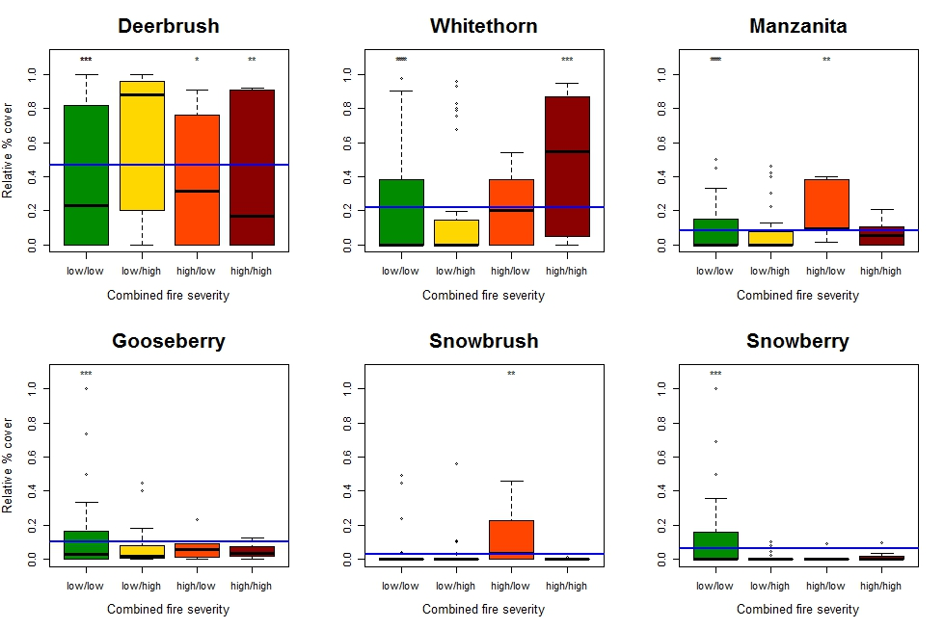
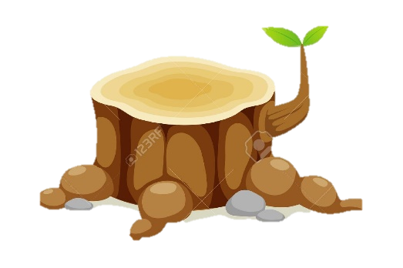
Seeders win with repeated fire

Slide 10
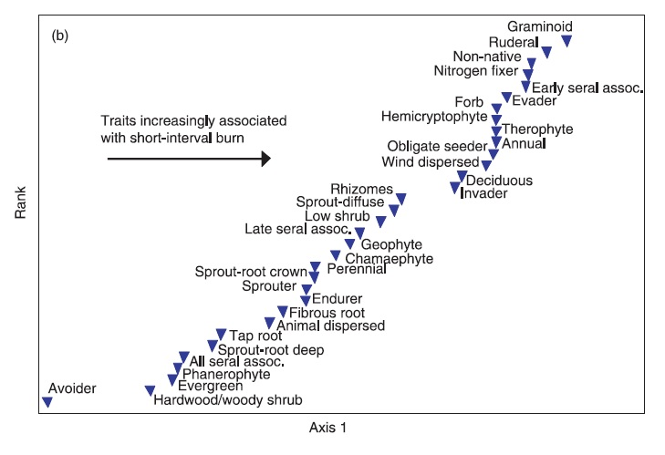
Seeders win with short-interval fire
Donato et al 2012

Slide 11
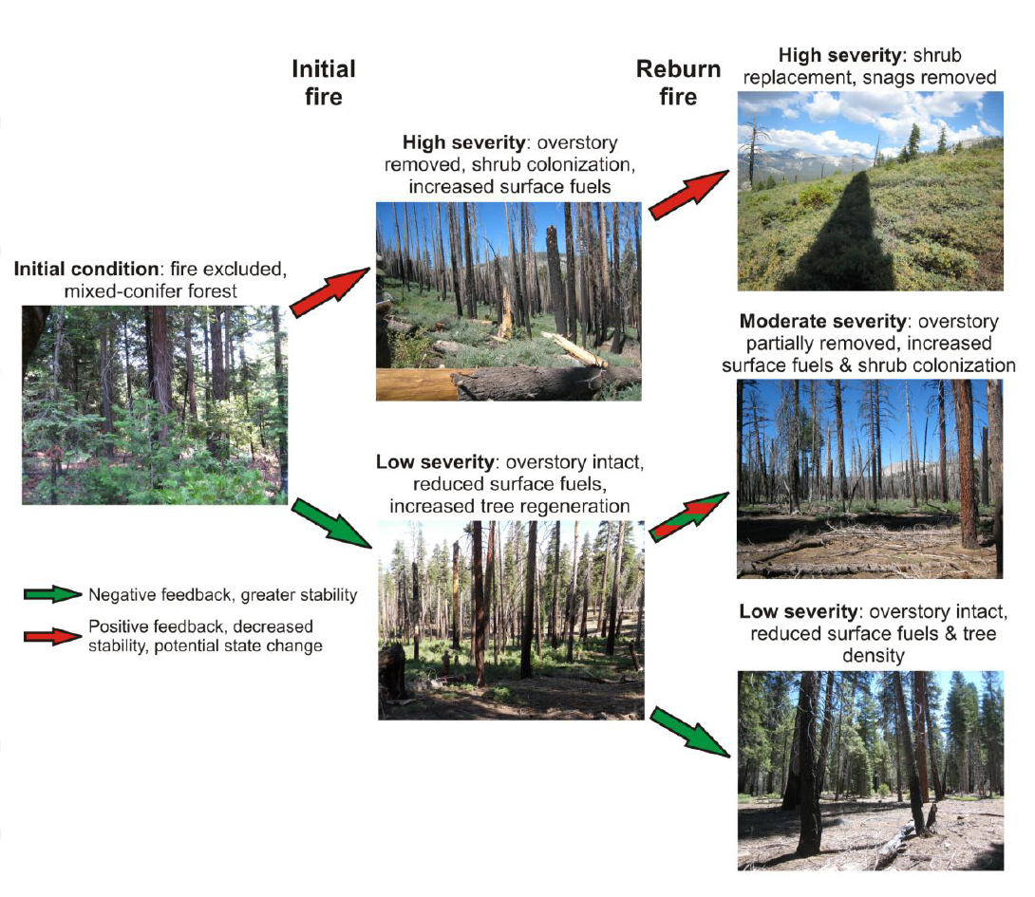
Alternative vegetative states
Initial fire
Re-burn
High severity
High severity
Initial condition
Moderate severity
Coppoletta et al. 2015 Ecosphere
Low severity
Low severity

Slide 12
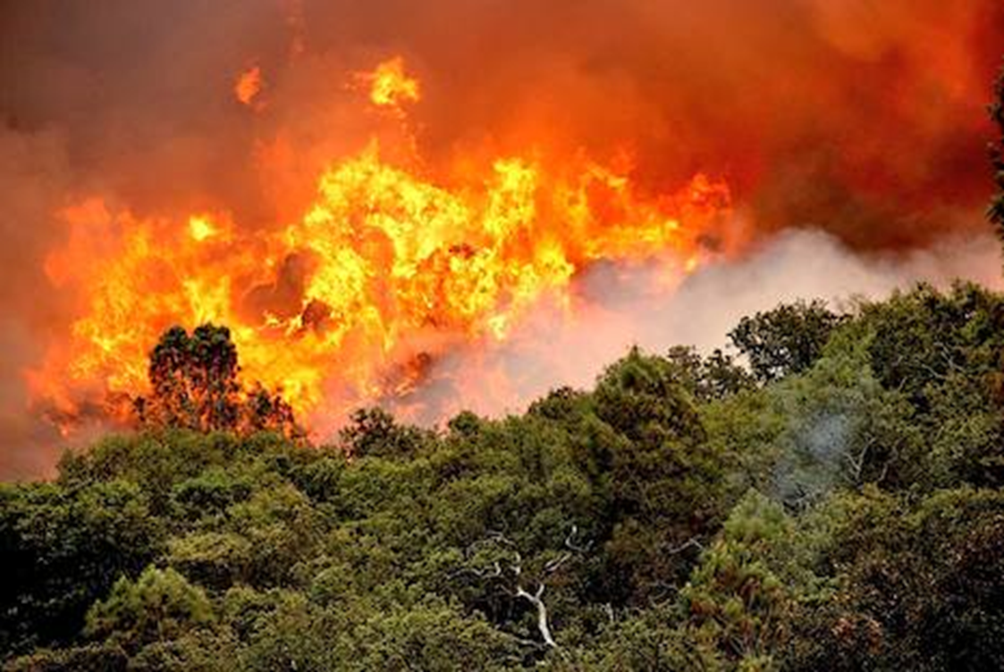
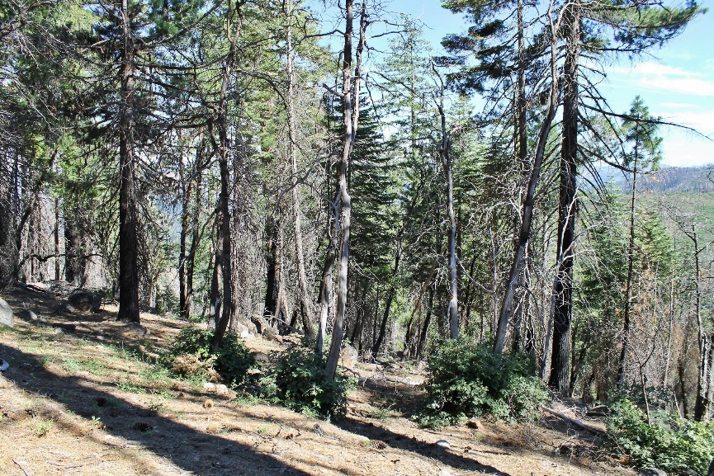
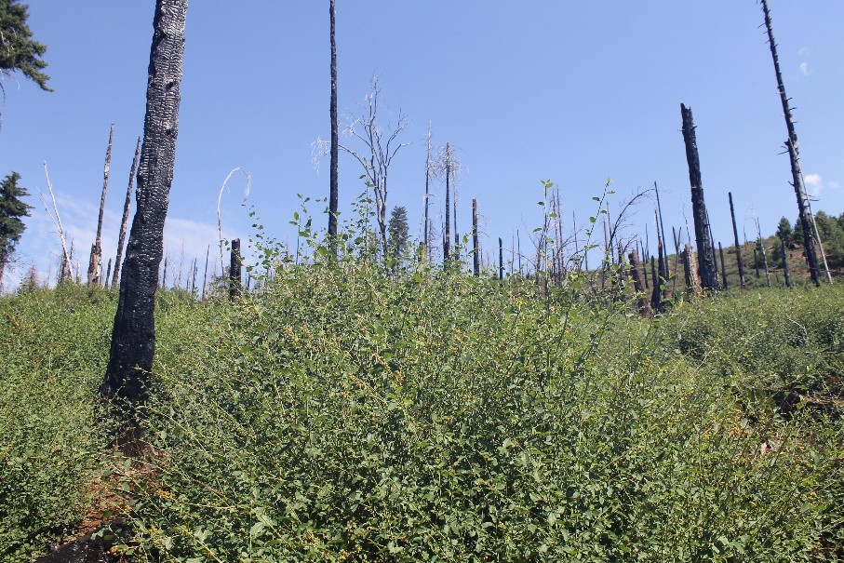
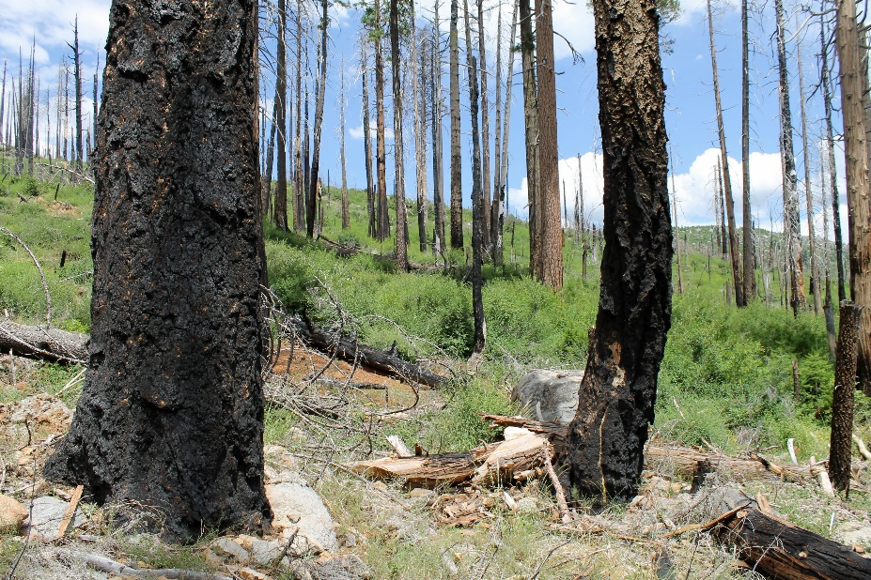
Implications:
High-severity fire -> type shift
Frequent fire -> evaders
↑ Landscape heterogeneity
Future fire behavior

Slide 13


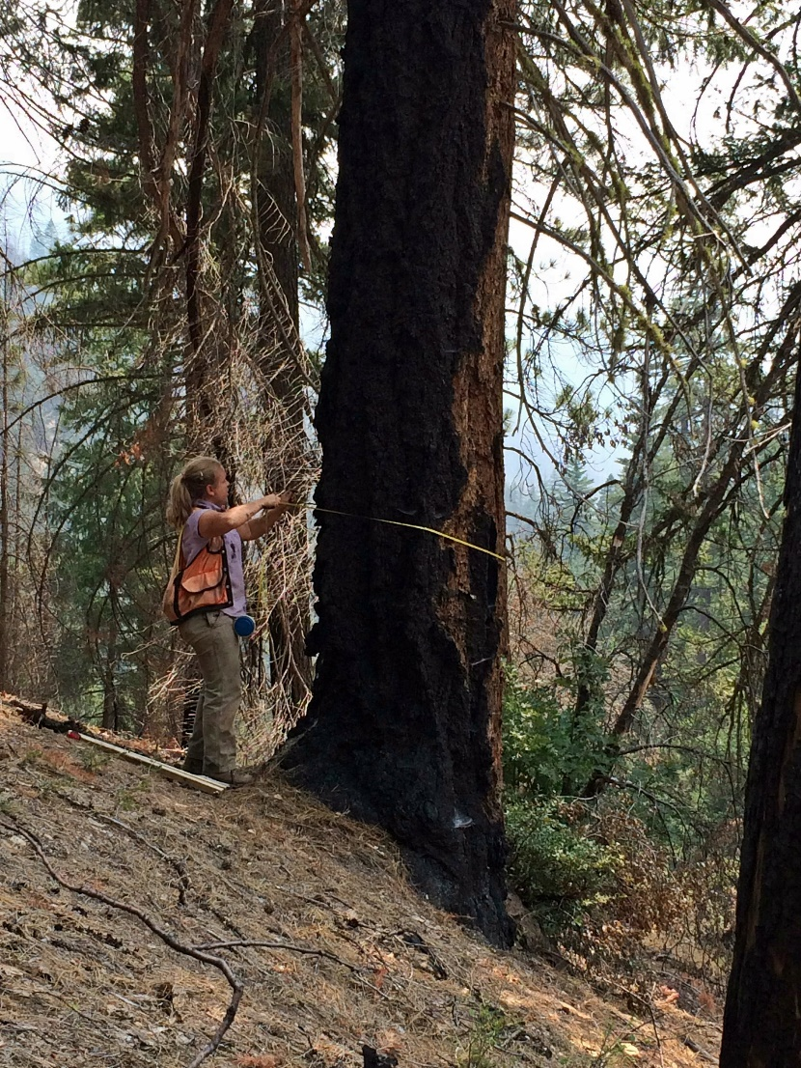
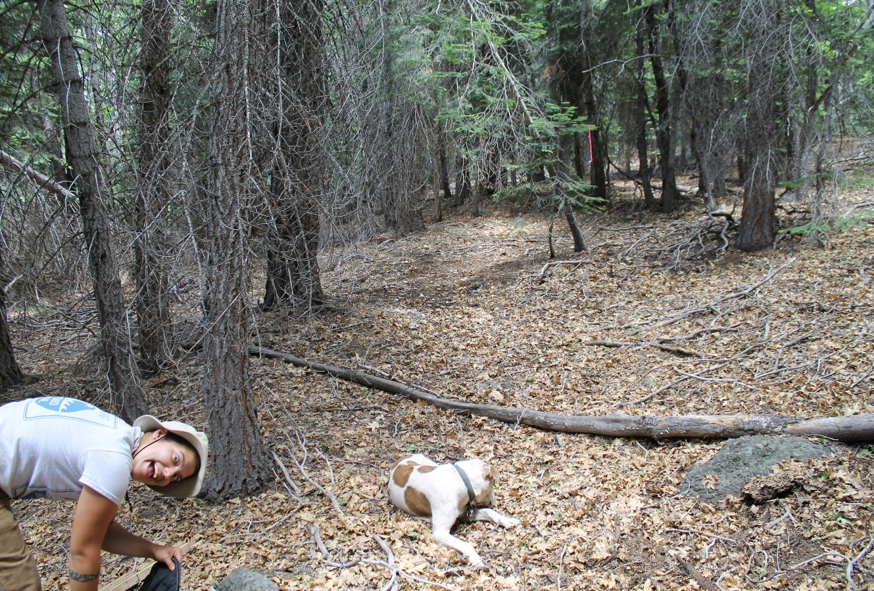
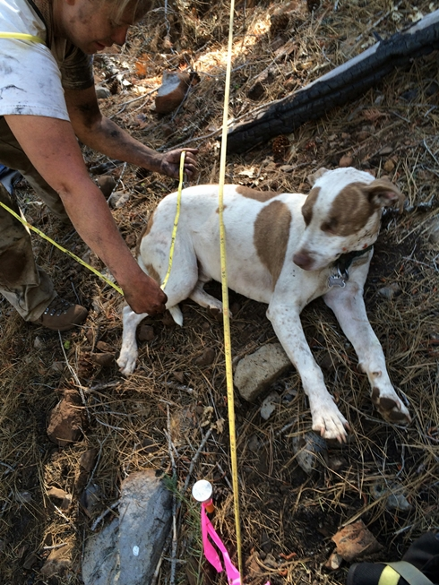
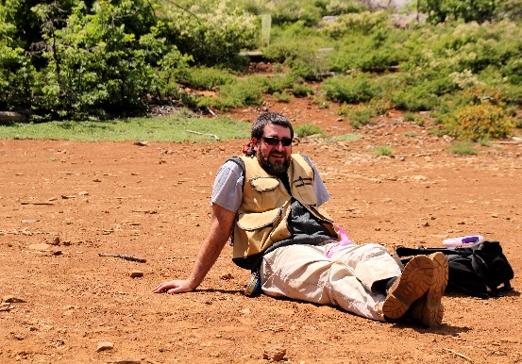
Acknowledgements
Notes:
Funded by USDA Forest Service Region 5
Would like to acknowledge many collaborators on this project, especially some very hard-working field assistants.

Slide 14
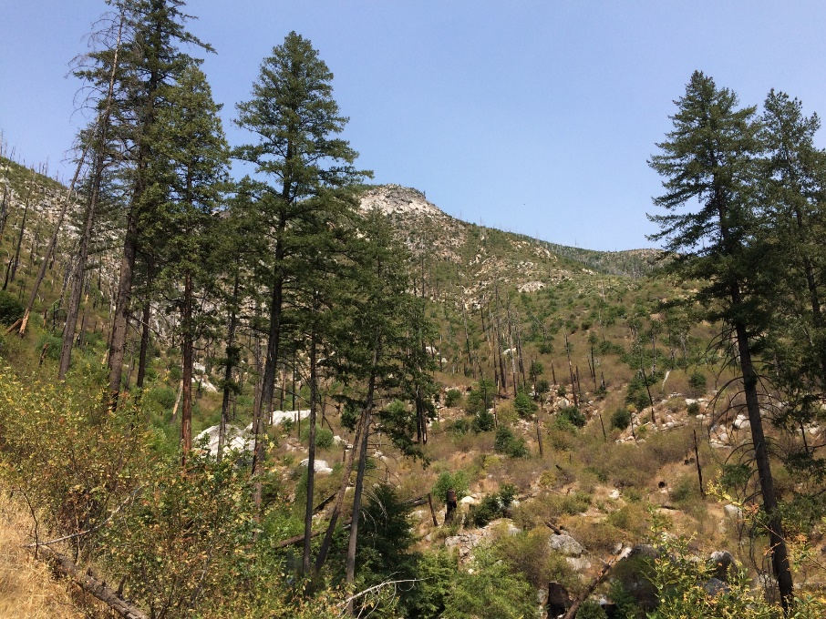
Questions?

Slide 15
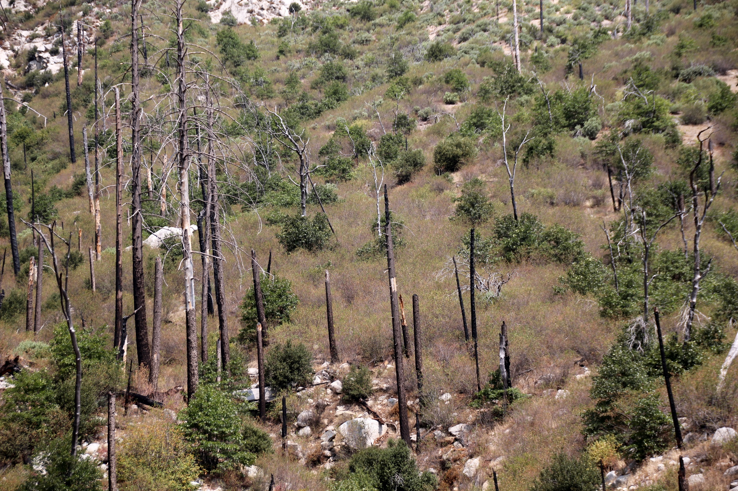
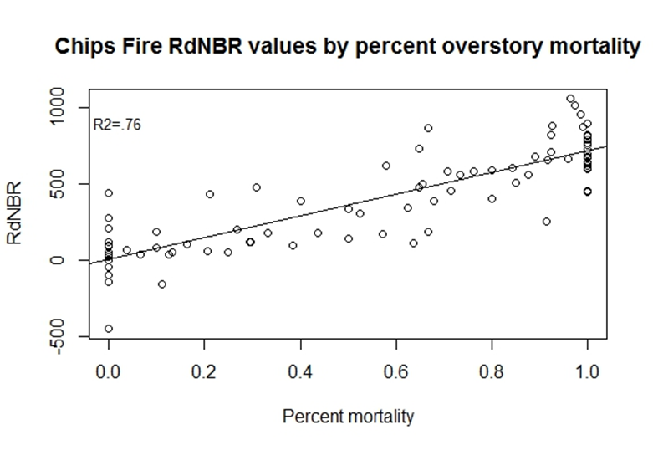

Slide 16
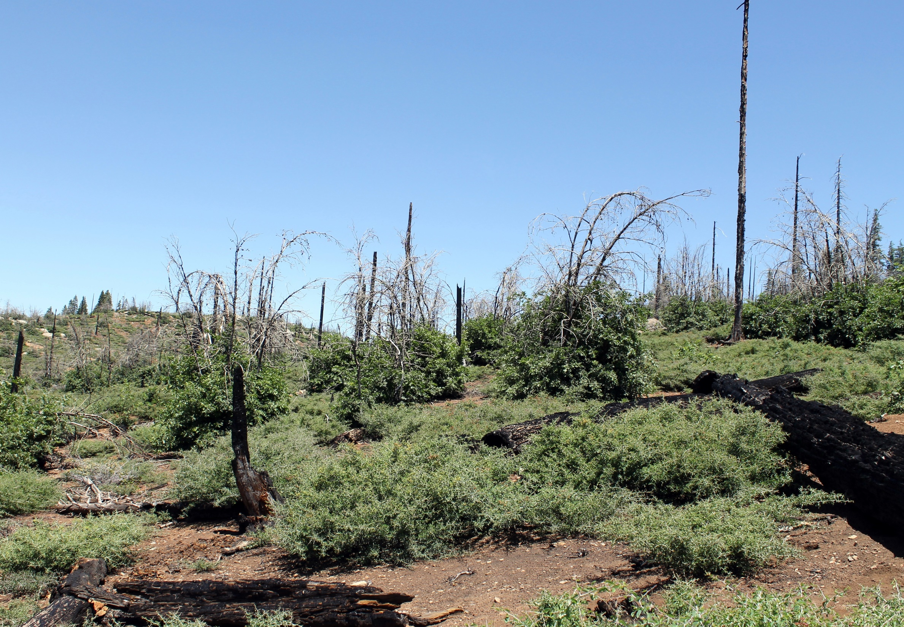
Low | High Low
Low High | High

